Slide 1
Business Level Strategies Week 6, Chapter 5, 2020
MGT703 Strategic Management

Slide 2
Notes:
This copyright notice should remain at the beginning of every lecture.

Slide 3

Three key concepts from Week Five
Concept 1: Building blocks of competitive advantage
Concept 2: Cost leadership & differentiation
Concept 3: Broad & narrow market segmentation

Slide 4

Learning objectives
Explain the difference between low-cost and differentiation strategies.
Articulate how the attainment of a differentiated or low-cost position can give a company a competitive advantage.
Discuss the concept of Blue Ocean Strategy

Slide 5

Business level strategies
Overall competitive theme of a business.
The way a company positions itself in the marketplace to gain a competitive advantage.
Different positioning strategies that can be used in different industry settings.

Slide 6
Lowering costs (LO1)
Enables a company to:
gain a competitive advantage in commodity markets.
undercut rivals on price.
gain market share.
maintain or increase profitability.

Slide 7
Differentiation (LO2)
Distinguishing oneself from rivals by offering something that they find hard to match
Two options
Low or no price increase to increase demand and volume of sales
Increase price at a greater level than costs to increase profit margin
Product differentiation is achieved through:
superior reliability, functions, and features.
better design, branding, point-of-sale service, after sales service, and support.
Advantages
Allows a company to charge a premium price.
Helps a company to grow overall demand and capture market share from its rivals.

Slide 8
The Low-cost/differentiation continuum
Positive performance: Best value provider
Low Cost
Differentiation
Negative performance: Stuck in the middle

Slide 9
Value innovation
Occurs when innovations achieve both efficiency and effectiveness in an industry
Enables greater value to be offered through superior differentiation at a lower cost than competitors
Enables a company to outperform its rivals for a longer period of time

Slide 10
Market segmentation
Decision of a company to group customers based on important differences in their needs to gain a competitive advantage.
Standardisation strategy - Producing a standardised product for the average customer, ignoring different segments.
Segmentation strategy - Producing different offerings for different segments, serving many segments or the entire market.
Focus strategy - Serving a limited number of segments or just one segment.

Slide 11
Comparison of market segmentation approaches
Standardisation strategy
Associated with lower costs than a segmented strategy
Segmentation
strategy
Involves customisation of product offerings, which drive up costs as:
Focus
strategy
Attempts to attain economies of scale through high sales volume
achieving economies of scale is difficult.
production and delivery costs tend to be high.
Have a higher cost structure as:
new product features and functions need to be added.
attaining economies of scale is difficult.

Slide 12
Business level strategies
Generic business-level strategy
Gives a company specific form of competitive position and advantage in relation to its rivals
Results in above-average profitability
Broad low-cost strategy
Lowering costs in order to lower prices and still make a profit
Broad differentiation strategy
When a company differentiates its product in some way
Focus strategy
Targeting a certain segment or niche and trying to be the low-cost provider or the differentiator in that niche

Slide 13
Business level strategies & competitive advantage
Low-cost companies
Charge low prices and still make profits
Absorb cost increases from suppliers
Offer deep discount prices for buyers
Differentiated companies
Withstand pricing pressure from powerful buyers and increase prices without buyer resistance
Absorb price increases from suppliers and pass them to customers without losing market share
Withstand substitute goods, as a result of brand loyalty

Slide 14
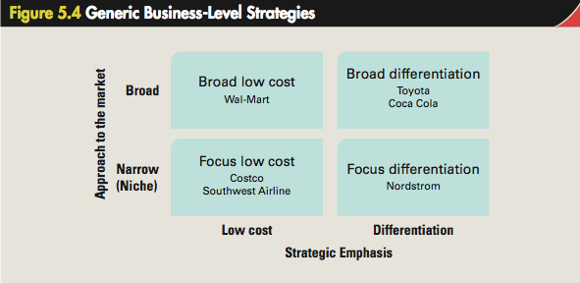
Generic Strategies Model (Strategy as position)

Slide 15
Aligning functional and business level strategies to lower costs
Achieve economies of scale and learning effects
Adopt lean production and flexible manufacturing technologies
Implement quality improvement methodologies to produce reliable goods.
Streamline processes
Use information systems to automate business process

Slide 16
Aligning functional and business level strategies to lower costs (cont’d)
Implement just-in-time inventory control systems.
Design products with a focus on reducing costs.
Increase customer retention.
Ensure that the organisation’s structure, systems, and culture reward actions that lead to:
higher productivity.
greater efficiency.

Slide 17
Aligning functional and business level strategies to differentiate
Customise product offering and marketing mix to different market segments.
Design product offerings that have a high perceived quality regarding their:
functions.
features.
performance.
reliability.
Handle and respond to customer queries and problems promptly.

Slide 18
Aligning functional and business level strategies to differentiate (cont’d)
Focus marketing efforts on:
brand building.
perceived differentiation from rivals.
Ensure employees act in a manner consistent with the company’s image.
Create the right organisational structure, controls, incentives, and culture.
Ensure that the control systems, incentive systems, and culture align with the strategic direction.

Slide 19

Blue Ocean Strategy
Successful companies build their competitive advantage by redefining their product offering through value innovation.
Creating a new market space.
Blue Ocean - Wide open market space where a company can chart its own course.

Slide 20
Blue Ocean Strategy
To redefine its market and create a new business-level strategy, a company must:
eliminate factors that rivals take for granted, and reduce costs.
reduce certain factors below industry standards, and lower costs.
raise certain factors above industry standards, and increase value.
create factors that rivals do not offer, and increase value.

Slide 21
Outlook
Week 6 Post-class activities
Review guideline responses to discussion questions
Attempt Chapter 5 quiz in the online interactive textbook
Week 7: “Business level strategy and the industry environment ” Pre-class activities
Read Chapter 6 of the online interactive textbook
Watch the summary video for Week 7
Prepare responses to the Week 7 discussion questions
Read the article provided on Blackboard

